Slide 1
Deep-Learning

Slide 2
The birth
1950 — Alan Turing creates the “Turing Test” to determine whether or not a machine is truly intelligent. In order to pass the test, the machine must be capable of making a human believe that it is another human instead of a computer.
1958 — Frank Rosenblatt designs the Perceptron, the first artificial neural network.

Slide 3
First Winter of AI [1974 – 1980]
In the second half of the 1970s, the field suffered its first “winter.” Various agencies that had been financing AI research cut funds after years of high expectations and few actual advances.
1979 — Students at Stanford University invent the “Stanford Cart,” a mobile robot capable of moving autonomously around a room while avoiding obstacles.
1967 — The algorithm “Nearest Neighbor” is written. This milestone is considered the birth of the field of pattern recognition in computers.

Slide 4
The Explosion of the 1980s [1980 – 1987]
The 80s are known as the birth of expert systems, based on rules. These were rapidly adopted by the corporate sector, generating new interest in Machine Learning.
1981 — Gerald Dejong introduces the concept of “Explanation Based Learning” (EBL), in which a computer analyzes the training data and creates general rules allowing the less important data to be discarded.
1985 — Terry Sejnowski invents NetTalk, which learns to pronounce words in the same way a child would learn to do.

Slide 5
Second AI Winter [1987 – 1993]
At the end of the 1980s and the beginning of the 90s, AI experienced a second “winter.” This time, its effects lasted for several years and the reputation of the field did not fully recover until the early 2000s.
1990s — Work in Machine Learning moves from a knowledge-driven focus to a data-driven one. Scientists begin to create programs that analyze large quantities of data and extract conclusions from the results.
1997 — The computer Deep Blue, by IBM, beats world chess champion Gary Kaspárov.

Slide 6
Explosion and Commercial Adoption [2006 – Present Day] Part 1
The growth in the potential for calculation together with the great abundance of available data have relaunched the field of Machine Learning. Many businesses are moving their companies towards data and incorporating Machine Learning into its processes, products and services in order to gain an edge over their competition.
2006 — Geoffrey Hinton coined the phrase “Deep Learning” to explain the new architectures of profound neural networks capable of learning much better models.
2011 — The Watson computer by IBM beats it human competitors at Jeopardy, a game show that consists of answering questions in natural language.
2012 — Jeff Dean, at Google, with the assistance of Andrew Ng (Stanford University), leads the project GoogleBrain, which developed a deep neural network using all of the capacity of the Google infrastructure to detect patterns in videos and images.
2012 — Geoffrey Hinton leads the winning team in the Computer Vision contest at Imagenet using a deep neural network (DNN). The team won by a large margin, giving rise to the current explosion of Machine Learning based on DNNs.

Slide 7
Explosion and Commercial Adoption [2006 – Present Day] Part 2
2012 — The research laboratory Google X uses GoogleBrain to autonomously analyze Youtube videos and detect those containing cats.
2014 — Facebook develops DeepFace, an algorithm based on DNNs capable of recognizing people with the same precision as a human being.
2014 — Google buys DeepMind, a British deep learning startup that had recently demonstrated DNN capabilities with an algorithm capable of playing Atari games by simply viewing the pixels on the screen, the same way a person would. The algorithm, after hours of training, was capable of beating human experts in the games.
2015 — Amazon launches its own Machine Learning platform.
2015 — Microsoft creates the “Distributed Machine Learning Toolkit”, which allows for the efficient distribution of machine learning problems to multiple computers.
2015 — Elon Musk and Sam Altman, among others, found the non-profit organization OpenAI, providing it with one billion dollars with the objective of ensuring that artificial intelligence has a positive impact on humanity.
2016 – Google DeepMind beats professional Go player Lee Sedol five games to one at what is considered to be one of the most complex board games. Expert Go players confirmed that the algorithm was capable of making “creative” moves that they had never seen before.
2017 –Elon Musk’s OpenAI beats the top 8 player and the current champion 2-0 in DOTA

Slide 8
Outline
Green Title: Conceptual, Analysis
Lectures with green titles will be purely conceptual lectures there we will give definition (without going in details to the math) on key concepts of machine learning, also analyze some of its components. Those lecture are helpful to familiarize the reader with the type of situation that occur in solving a problem also the wright way to deal with them.
Red Title : Mathematical , Theoretical
These lecture will help transfer the concepts and mechanics of machine learning into equations and mathematical formulas. And learn how to tailor them to fit any given problem theoretically, and derive the concepts of the different algorithms
Blue Title: Technique, Practical
In those lectures we will turn the algorithms established in the in theoretical lectures into real programs with Python, TensorFlow, Theano, Scikit-Learn.

Slide 9
Title Of the lecture | Overview
The learning Problem | Here we will define what’s a learning problem and the criteria of the applications of machine learning to solve a given problem, also the different type of learning in literature.
Is learning Feasible? | Can we generalize from data? What conditions do this data have in order to export the learning model?
Linear Regression | This lecture will serve both as a hands on introduction to the simplest learning algorithm, and to the different frameworks scikit-learn, theano, TensorFlow.

Slide 10
Data Cleaning And Data preparation | An off topic lectures but necessary for dealing with real data, here we will take a look at incomplete datasets, false values, formatting, etc.
Overfitting Error and Noise | Somme concepts on real data issues and their replications.
Artificial Neural Networks | The Mathematics of Neural Networks.
Deep Neural Networks | Application of DNN using TensorFlow on serval examples.
Convolutional Neural Networks | Application of CNN using TensoFlow on multiple examples.
Recurrent Neural Networks | Application of RNN using TensorFlow, Keras or Contrib.Layers on some examples.

Slide 11
The Learning Problem
What is machine learning
Problem solving using machine learning
The components of Machine learning
Design Vs Learning
Types of machine learning

Slide 12
The essence of Machine Learning
Learning from data is used in situations where we don't have an analytic solution, but we do have data that we can use to construct an empirical solution. There are 3 indispensable things that needs to exist within the problem for it to be a learning problem.
1. Existence of a pattern.
2. Cannot pin it down mathematically i.e. cannot write a formula that explains the underling system.
3. We need GOOD DATA.

Slide 13
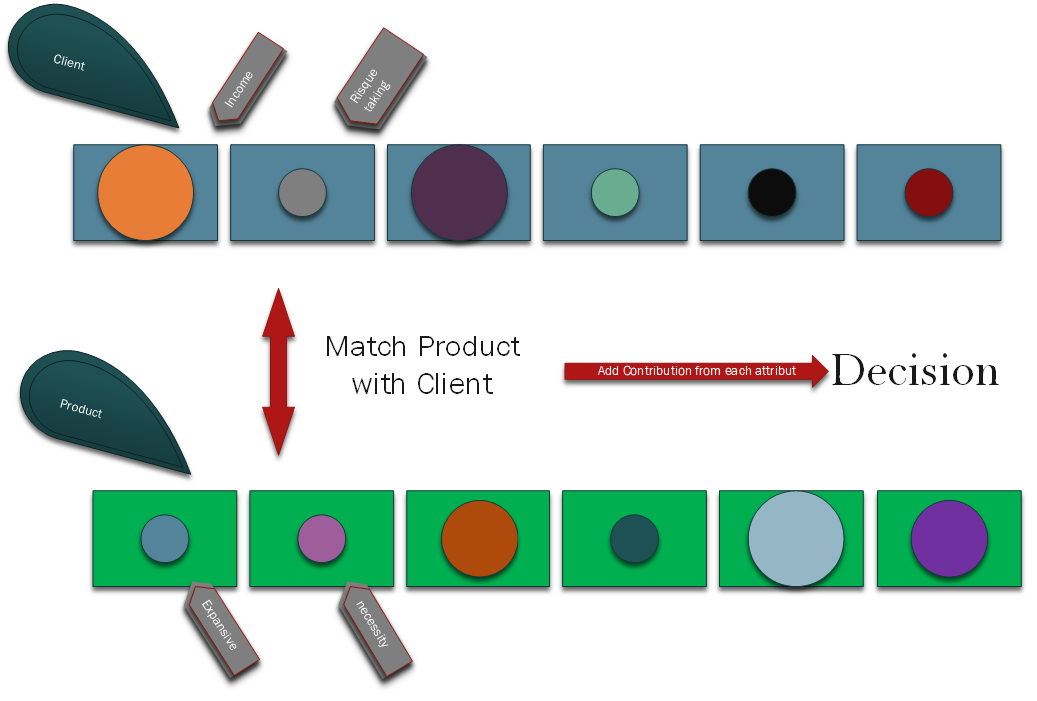
Exemple: Recommander System

Slide 14
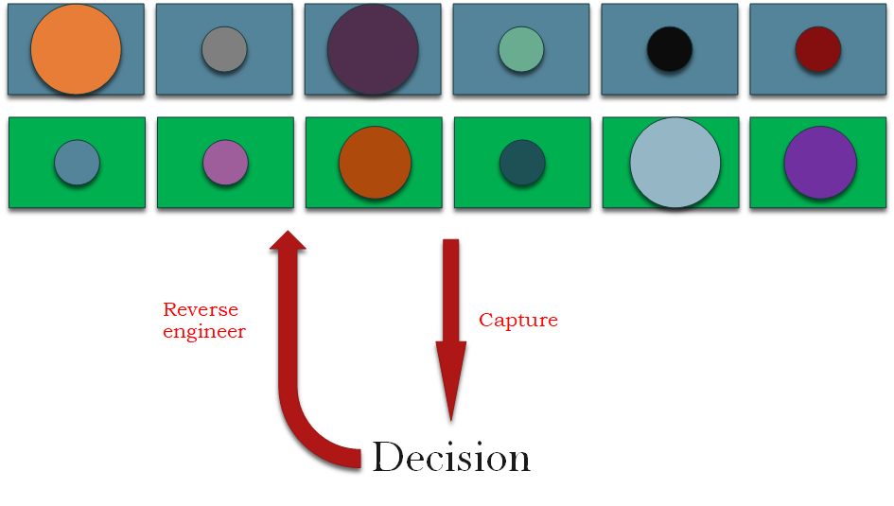
Machine Learning approche

Slide 15
The power of learning from data is that the process of figuring out the decision can be automated, without any need for analyzing either the client profile or the product attributes.

Slide 16
The Mathematical component of the learning process
Input : x in X (example: Clients information)
Output: y in Y (example: Decisions buy a certain Product or not)
Target function f:X→Y (this function is unknown and represents the taste of the client if it can be pin point mathematically, this is the function that we trying to find)
Data, comes in pairs {(x₁ ,y₁)…(x_{N},y_{N})}
The Hypothesis g:X→Y (g approximate f)
The learning algorithm A that tries to find g in the hypothesis set H (example H could be the set of all linear formulas from which the algorithm would choose the best linear fit (g) to the data)

Slide 17
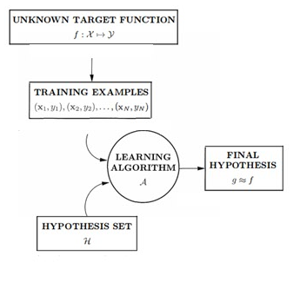
The ideal formula that captures the interest of a client
The data available like profile information and past purchases
List of candidate formulas
The final function given by A
The system witch picks the best formula from H

Slide 18
Given a specific learning problem, the target function and training examples are dictated by the problem. However, the learning algorithm and hypothesis set are not. These are solution tools that we get to choose. The hypothesis set and learning algorithm are referred to informally as the learning model. Here two example of a learning model:
1. H: Neural Network; Learning Algorithm A: Backpropagation.
2. H: Support Vector Machine; Learning Algorithm A: Quadratic Programing.

Slide 19
Exemple of a Machine Learning Algorithme: the perceptron
useless algorithm but simple
We will start by defining the different components of figure above using the example of the client/product already introduced
Input x the client attribute or X =R^{d}
Output y in Y={-1,1} as y=-1 if he didn’t buy the product y=1 if he did buy the product
H is the space of all linear function from X→Y so g is a linear separator (and hence its uselessness). We note H= {h} or h linear combination of the input x and some free parameters that we will define next.

Slide 20
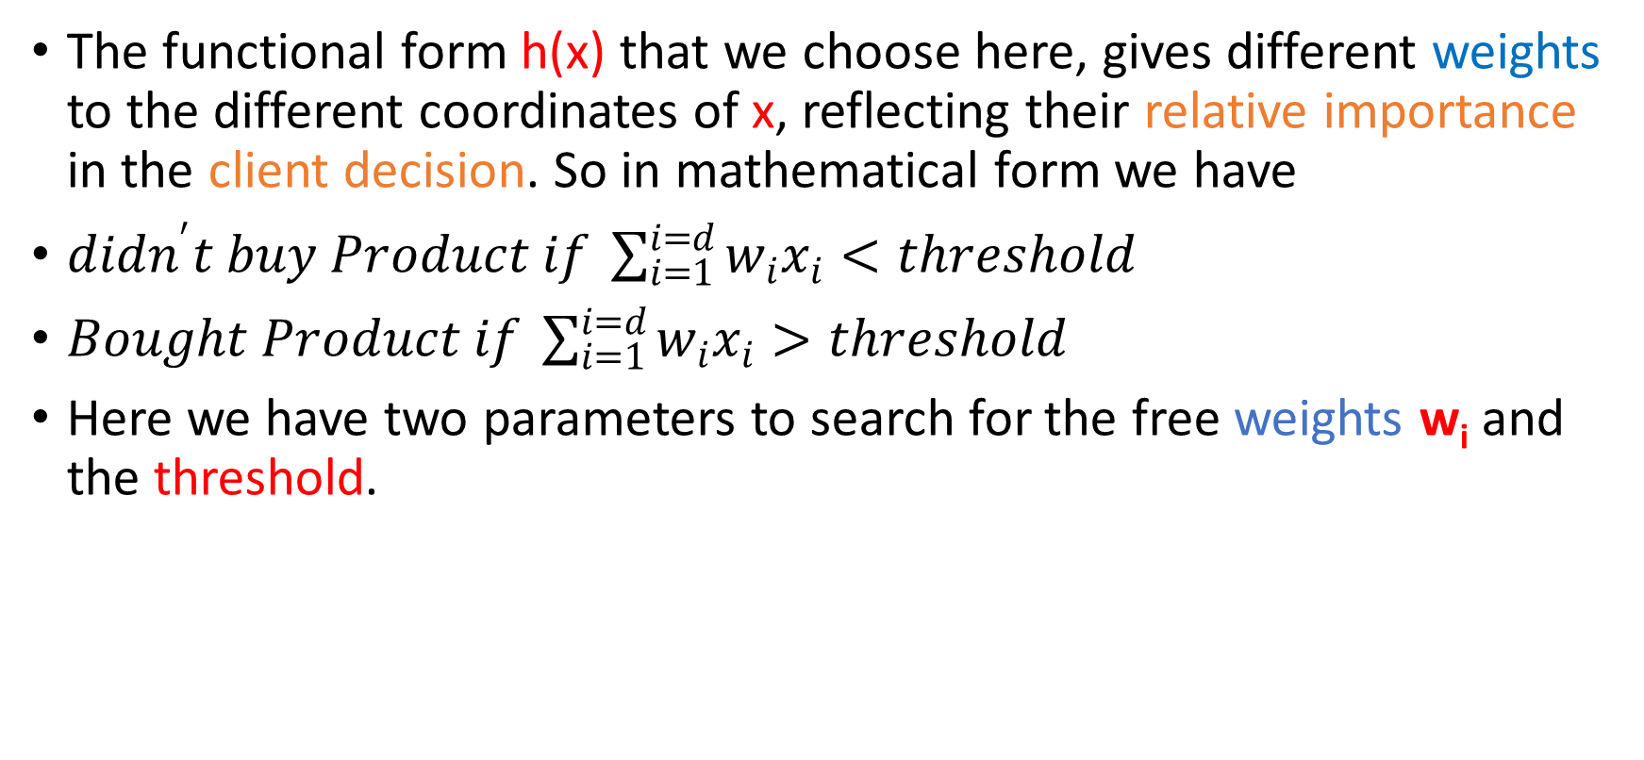
The functional form h(x) that we choose here, gives different weights to the different coordinates of x, reflecting their relative importance in the client decision. So in mathematical form we have
$didn^{′}t buy Product if \sum_{i=1}^{i=d}{w_{i}x_{i}}<threshold$
$Bought Product if \sum_{i=1}^{i=d}{w_{i}x_{i}}>threshold$
Here we have two parameters to search for the free weights w_{i} and the threshold.

Slide 21
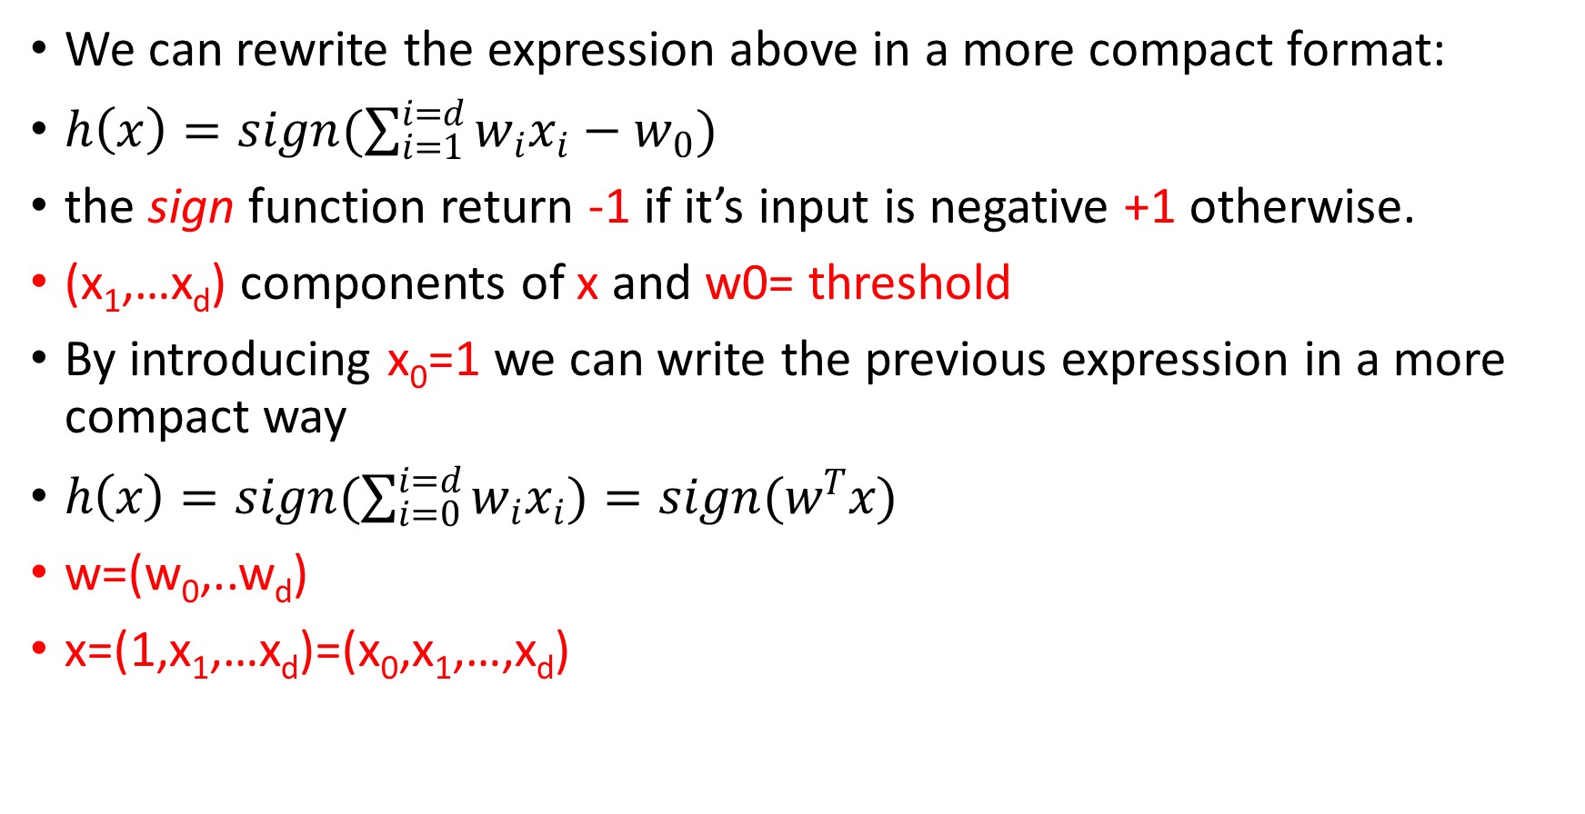
We can rewrite the expression above in a more compact format:
$h\left(x\right)=sign(\sum_{i=1}^{i=d}{w_{i}x_{i}}−w_{0})$
the sign function return -1 if it’s input is negative +1 otherwise.
(x₁,…x_{d}) components of x and w0= threshold
By introducing x₀=1 we can write the previous expression in a more compact way
$h\left(x\right)=sign(\sum_{i=0}^{i=d}{w_{i}x_{i})=sign(w^{T}x)}$
w=(w₀,..w_{d})
x=(1,x₁,…x_{d})=(x₀,x₁,…,x_{d})

Slide 22
perceptron learning algorithm PLA
As long as there is a misclassification:
Pick a misclassified pair form the data as (x(t),y(t))
Update the weights by:
W(t+1)=w(t)+y(t)x(t)
Test the new weight on all the data
repeat

Slide 23
Design VS Learning
The goal is to distinguish between learning and a related approach that is used for similar problems. While learning is based on data, this other approach does not use data. It is a “design” approach based on specifications (example: the dynamics of systems like Partial Differential Equations, Dynamic Programing and Optimal Control, Modeling by Mathematical Programing, inferential Statistics, descriptive Statistics, …) , and is often discussed alongside the learning approach in pattern recognition literature.

Slide 24
The Learning Approach
We are given samples from each classes of rocks and we use them as our data set. We take the percentages of chemicals as our input vector x and the class number as output y. there are some variation in the values of the chemical composites, but each samples of a given class tends to cluster around a focal point. Then the learning algorithm define the boundaries of each class.

Slide 25
The Design Approach
We call a specialist to give us information about the geothermal dynamics on how chemical component form various crystals, and how different combination of crystals cluster to form rocks. We also ask him about the number of different classes of rocks are in any given geographical place to figure out the relative frequency of each class of rocks. Finally, we make a physical model of the variations of the chemical component due to the geothermal forces and weather conditions based on every geolocation. We put all of this information together and compute the full joint probability distribution of the chemical components. Once we have that joint distribution, we can construct the optimal decision rule to classify the rocks.

Slide 26
Types of Learning
The basic premise of learning from data is the use of a set of observations to uncover an underlying process. It is a very broad premise, and difficult to fit into a single framework. As a result, different learning paradigms have arisen to deal with different situations and different assumptions. In this section, we introduce some of these paradigms.

Slide 27
Supervised Learning
When the training data contains explicit examples of what the correct output should be for a given inputs, then we are within the supervised learning setting. The most notable example is the classification of images using captions. Regression is another notorious example of supervised machine learning.

Slide 28
Unsupervised Learning
The training data does not contain any output information at all. We are just given input example, and the learning algorithm will try to find the correct pattern that flows through the data. The most notable example is K-Nearest-Neighbor often used in classification problems.

Slide 29
Reinforced Learning
This method of learning is most similar on how humans learn, here we are given the input and some output but not all, and also we grade the output, and the learning algorithm tries to figure a pattern by trial and error, in case of a classification problem a reinforced learning algorithm will get good grade if he classified the input correctly and bad grades if he didn’t this dynamic will push it to better itself after each data treatment. And it’s similar on how humans learn, if we are correct on a subject our brains will reward us with dopamine, and if we are not correct we feel a little bit of unease and discomfort.

